Slide 1
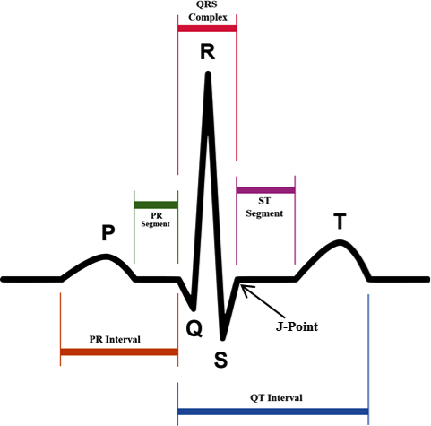
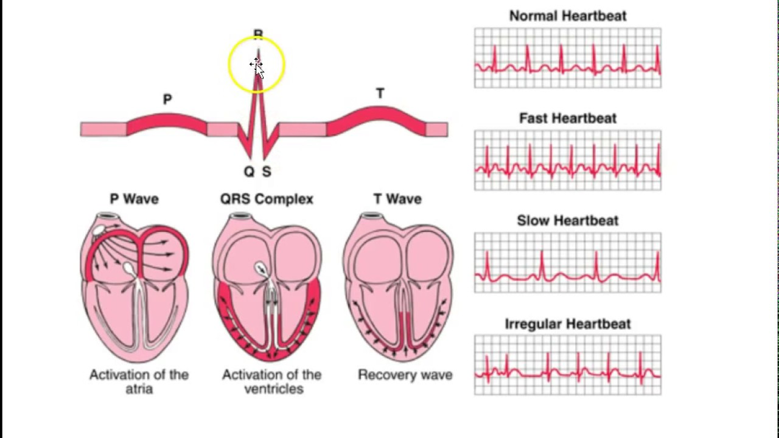
FINAL ECG MODULE
By: Michael Jimenez

Slide 2
ECG Subsystem Goal
GOAL:
Create an Electrocardiogram(ECG) circuit to detect the PQRST Signal(heart signal) by placing 3 leads(electrodes) onto the chest
INPUT/OUTPUT:
The heart signal ranges from 0.1mV-5mV and the ECG circuit outputs the signal to 325-350mV(gain of 300). The frequency of the ECG Signal on average is 1.8Hz.
COMPARATOR:
The comparator system captures the Rpeak of the signal by setting up the comparator to have a Voltage threshold of 52mV.
The Comparator outputs 1 every time the Rpeak is detected in the ECG circuit. Then this signal is sent to ADC converter which converts the signal to Digital format so the MCU can detect the Rpeak from the ECG Circuit.
Powered with 4.5 Voltage(3 Double AA Batteries)
Outcome: heart signal and BPM(beats per minute).

Slide 3
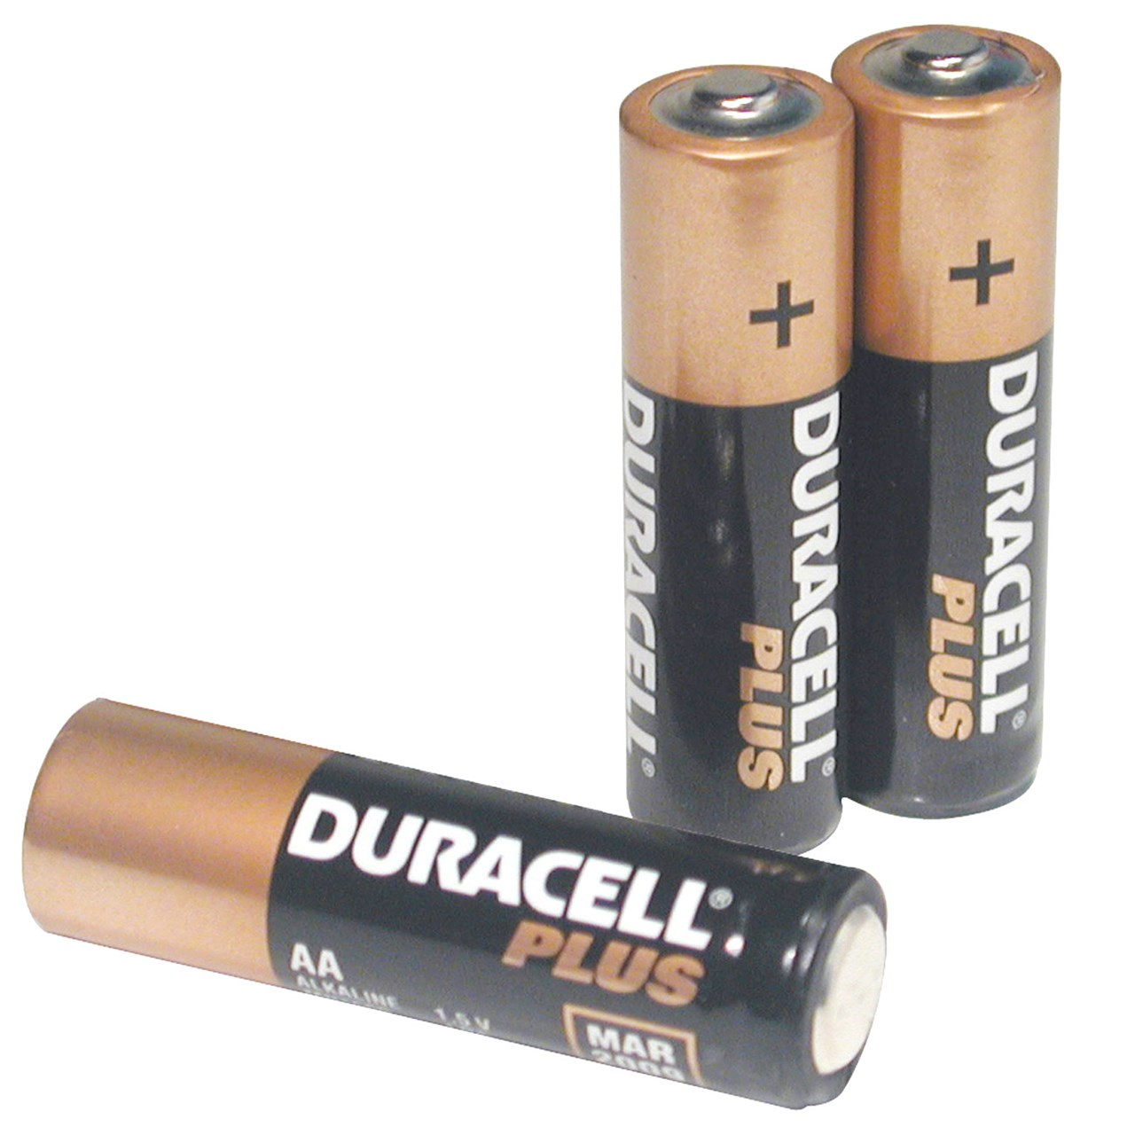
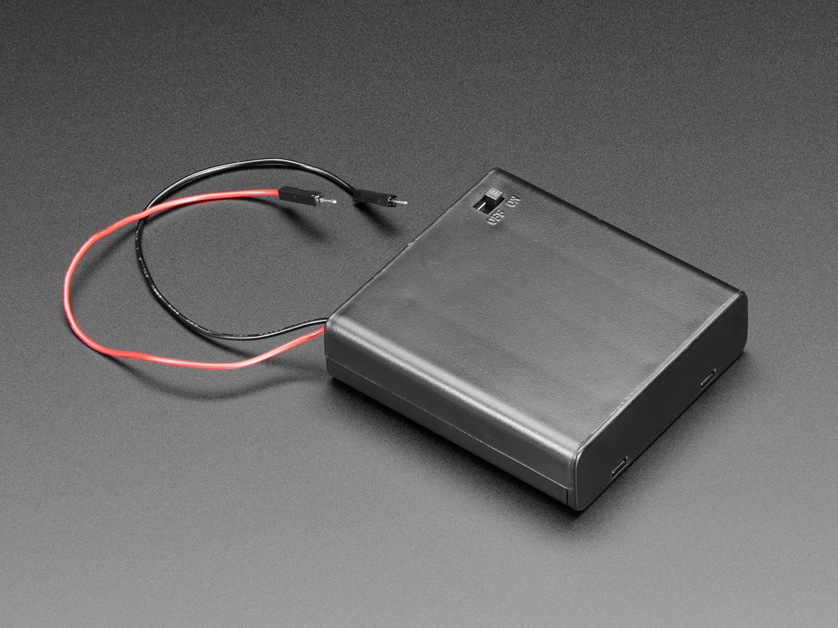
Power
POWER ECG Circuit with 4.5 Volts using 3 Double AA batteries

Slide 4

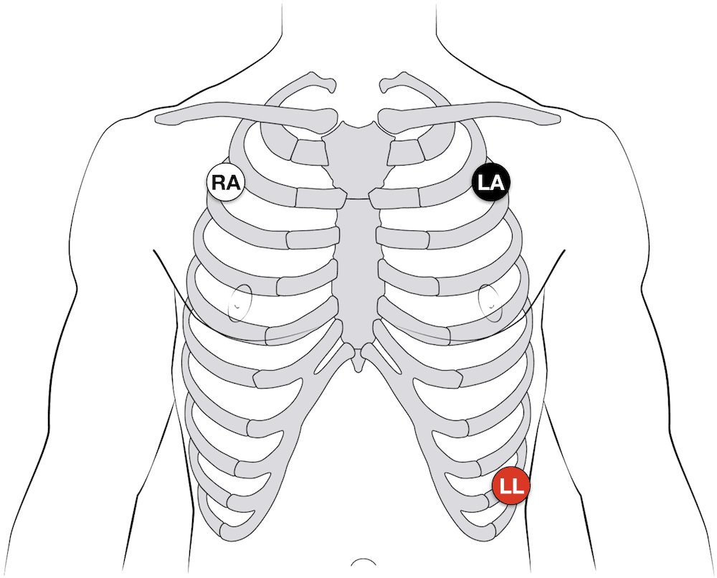
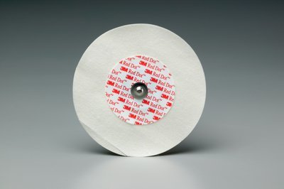
Electrodes Positioning
Gel Electrodes are used with a 3 Lead Auxiliary Cord Wiring.

Slide 5
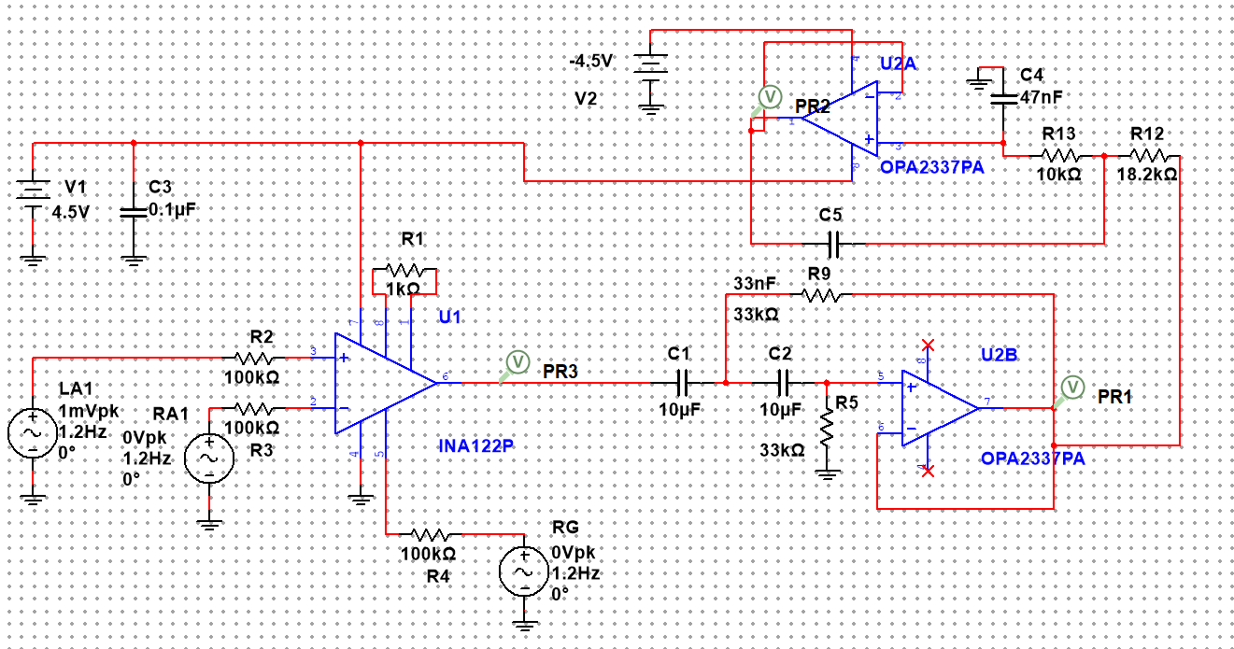
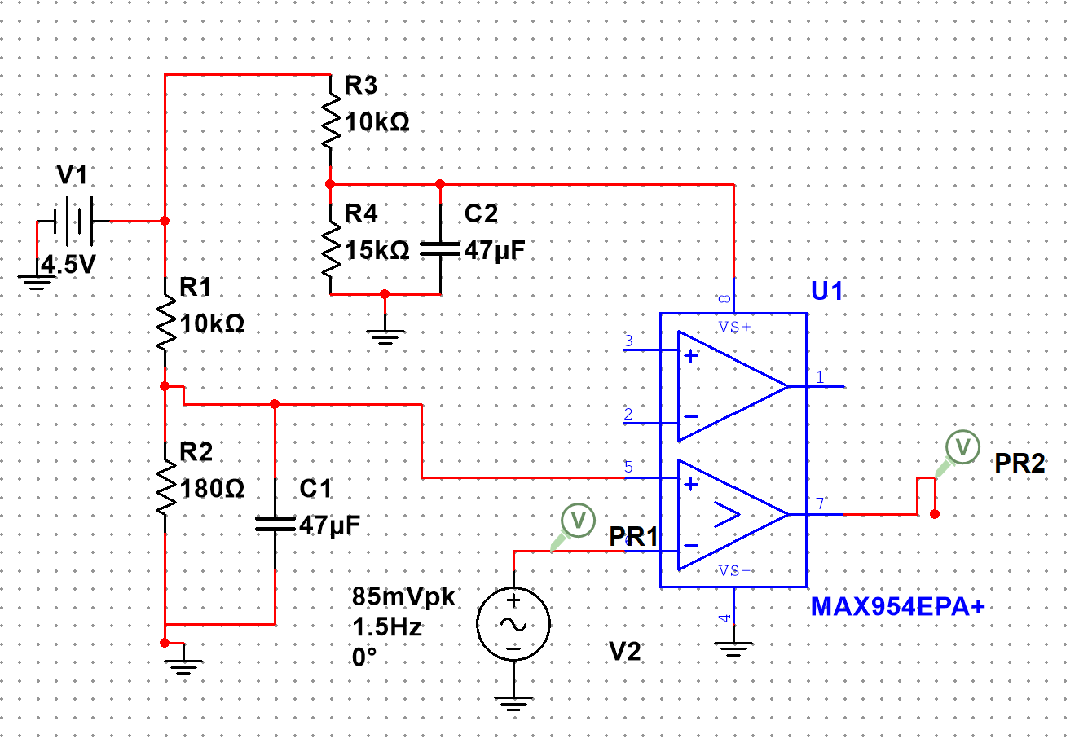
4 Stage ECG Circuit
Consists of
Instrumentation Amplifier
Low Pass Filter
High Pass Filter
Comparator

Slide 6
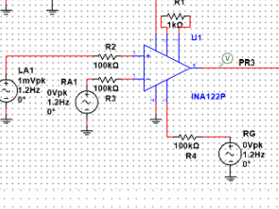
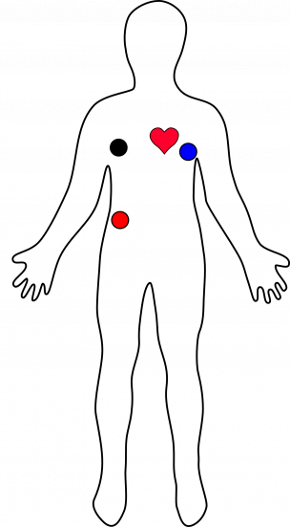
1st Stage ECG Circuit
Instrumentation Amplifier
Electrode Placement: Left Side, Right Side, Right Ground
Input Signal: 0.1-5mV
Amplify ECG signal to 300mV
Send the ECG Signal to High Pass/Low Pass Filter
To remove any noise
Cable Color | Signal
Black | RA (Righ)
Blue | LA (Left)
Red | RG (Right lower stomach)

Slide 7
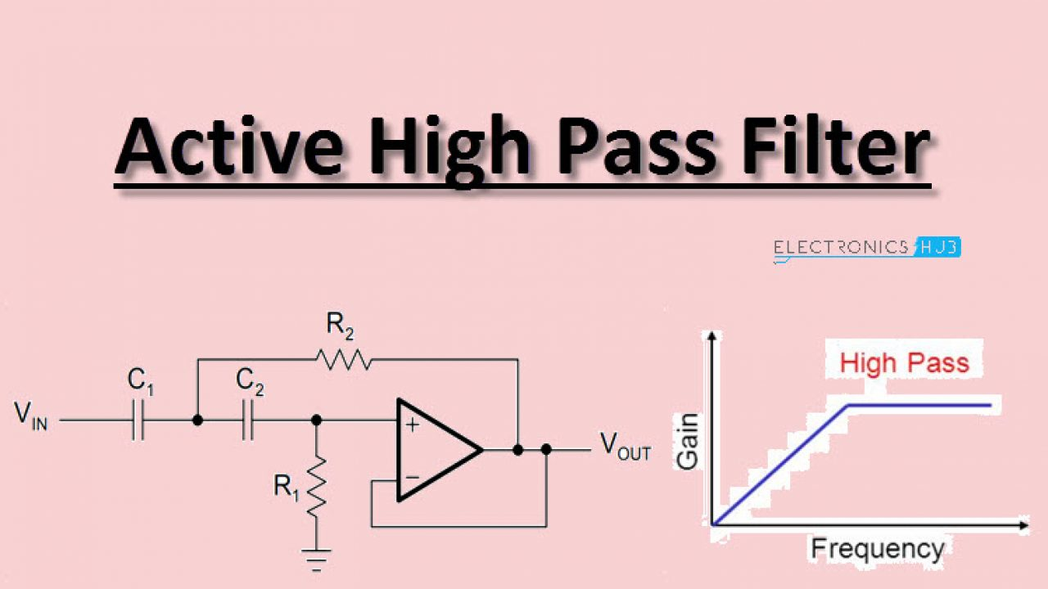
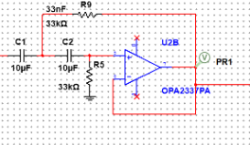
2nd Stage ECG Circuit
High Pass Filter(>0.5Hz)
Filter out anything below 0.5Hz

Slide 8
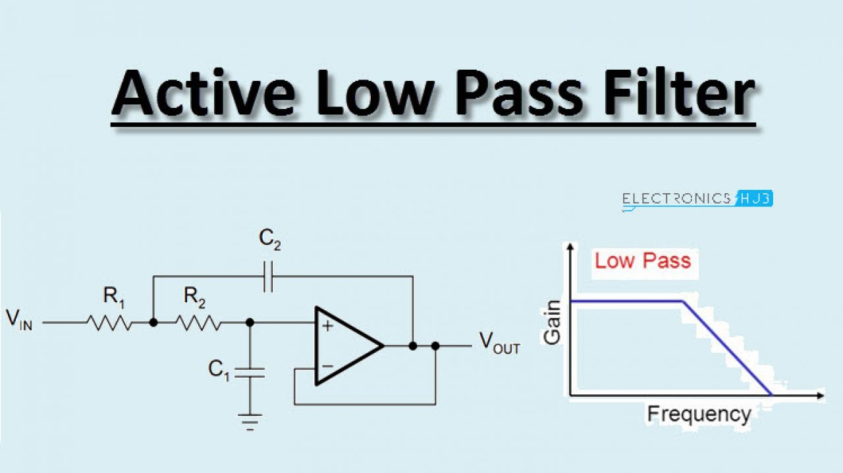
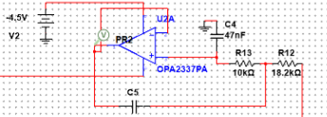
3rd Stage ECG Circuit
Low Pass Filter(<150Hz)
Filter anything above 150Hz

Slide 9
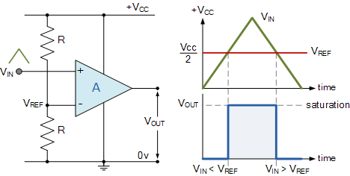
Comparator Module
Detect RPeak
Signal Outputs 1 when:
Rpeak is detected in the ECG SIGNAL
Voltage Threshold is 53mV so the signal captures Rpeak every 1.01Hz

Slide 10
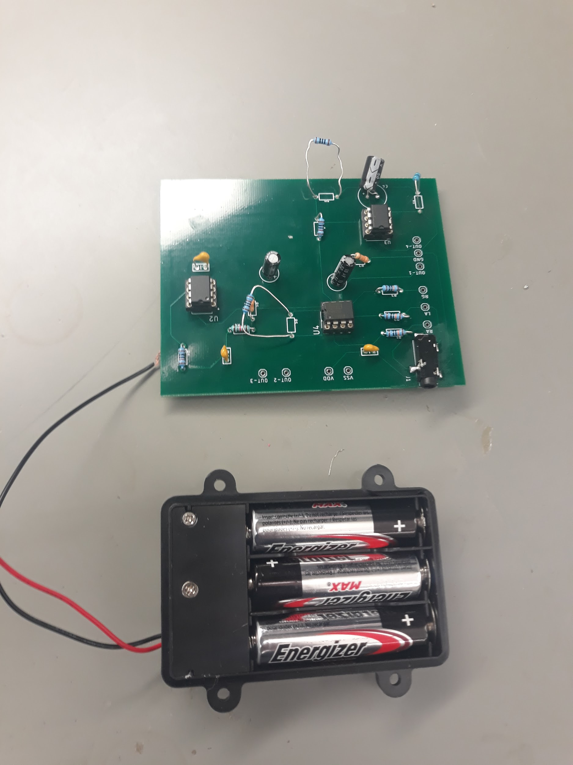
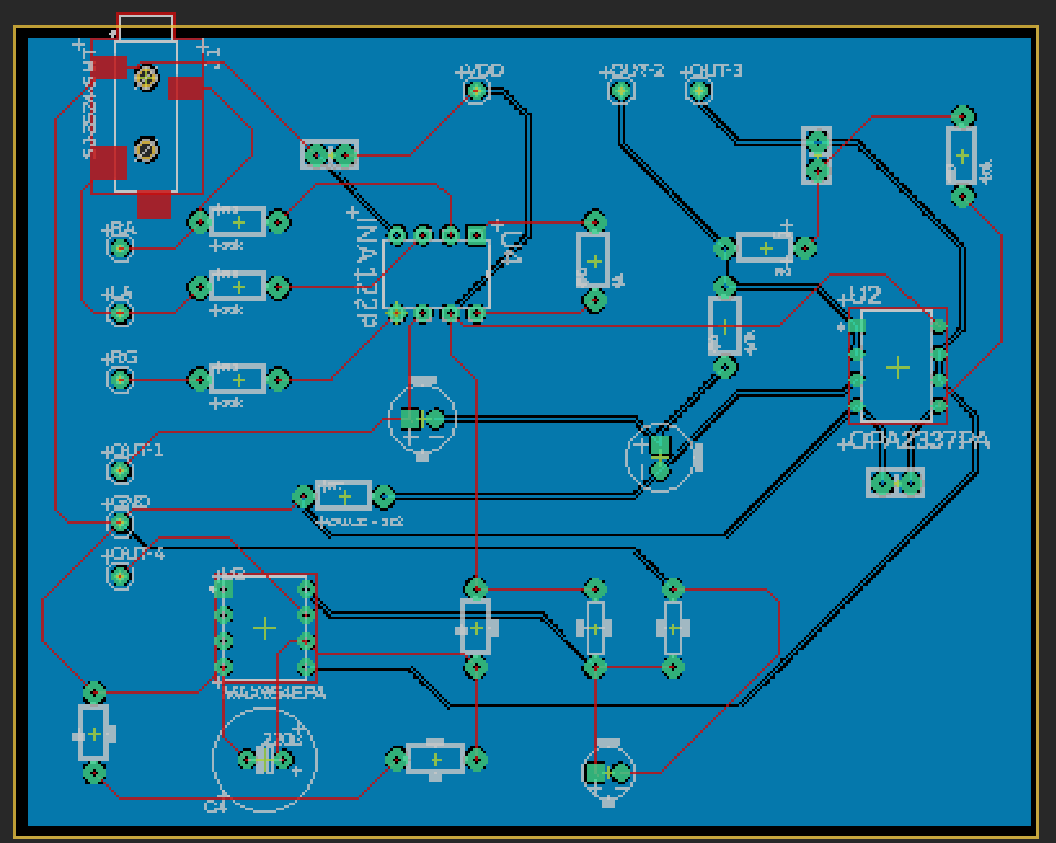
PCB Board

Slide 11
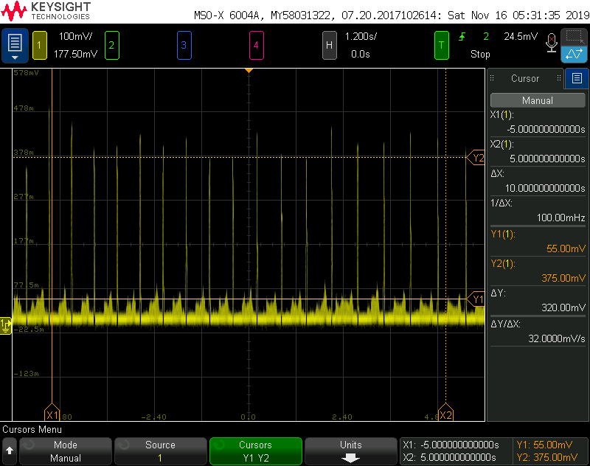
ECG Signal

Slide 12
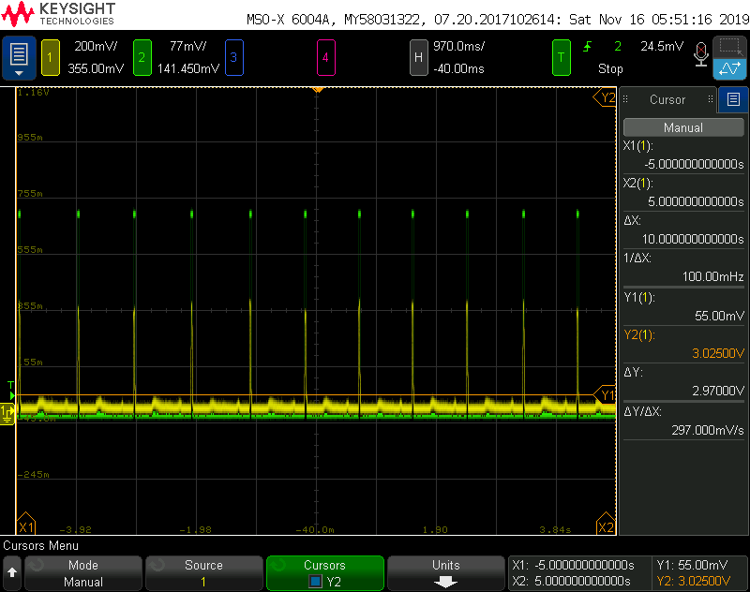
Comparator Signal/ECG Signal

